Slide 1
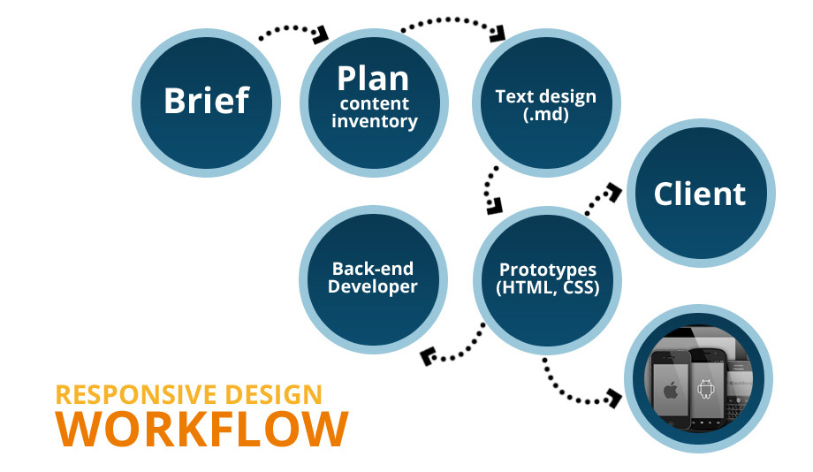

Slide 2
RWD
Responsive workflow

Slide 4


